Slide 1
23: Bayesian Learning, Unsupervised Learning, and EM Algorithms
CSCI 561 Foundation for Artificial Intelligence
Professor Wei-Min Shen
University of Southern California

Slide 2
Outline
Bayesian Learning
Unsupervised Learning (clustering)
Naïve Bayes Models (e.g., Autoclasses)
K-Means Clustering Algorithm
The EM algorithm
The Crown-Jewel of Machine Learning !!!
I am so proud that you are learning this ☺

Slide 3

Your Journey in this AI Class
😇
Learn AI and ML
Learn how to learn by yourself
EM Algorithm
Machine Learning
Probability Reasoning
Logic/Knowledge Representation
General AI

Slide 4
Notations Used (for your preparation)
Data
D={D₁,D₂, …} or sometimes X={x₁,x₂, …}
Concepts, Theories, or Hypotheses
C={C₁,C₂, …} or sometimes X={X₁,X₂, …}
Background knowledge/information at time t = 0,1,2,…
{X_{t=0}, X_{t=1}, X_{t=2}, …} or sometimes {C_{t=0}, C_{t=1}, C_{t=2}, …}

Slide 5
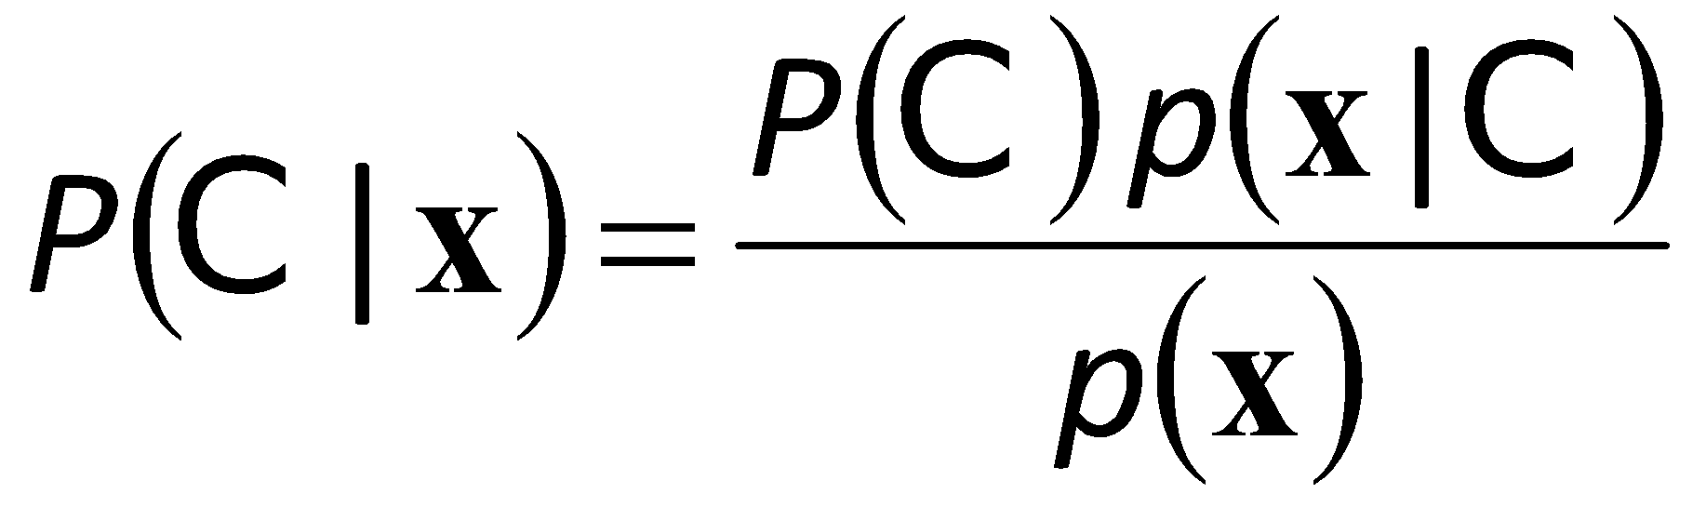
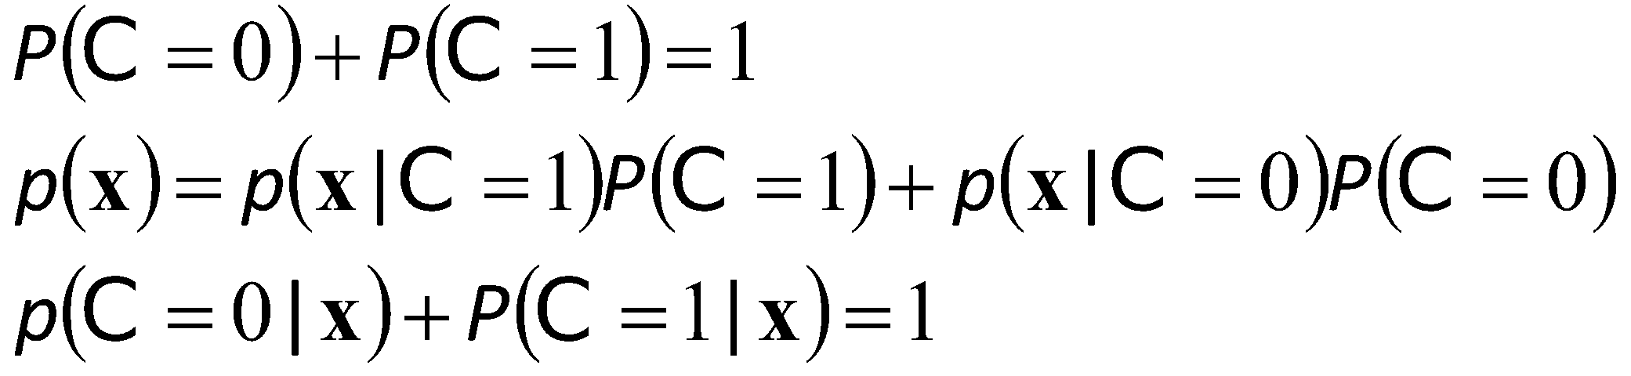
Bayes’ Rule
prior
likelihood
posterior
// x is data D_{t}
// C is the concept or theory
evidence

Slide 6
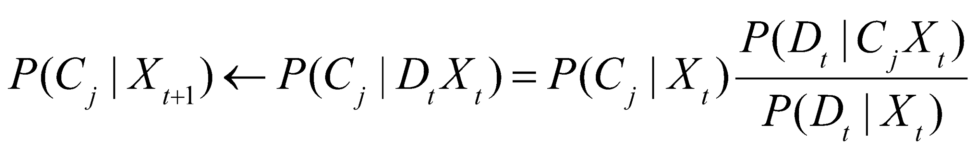
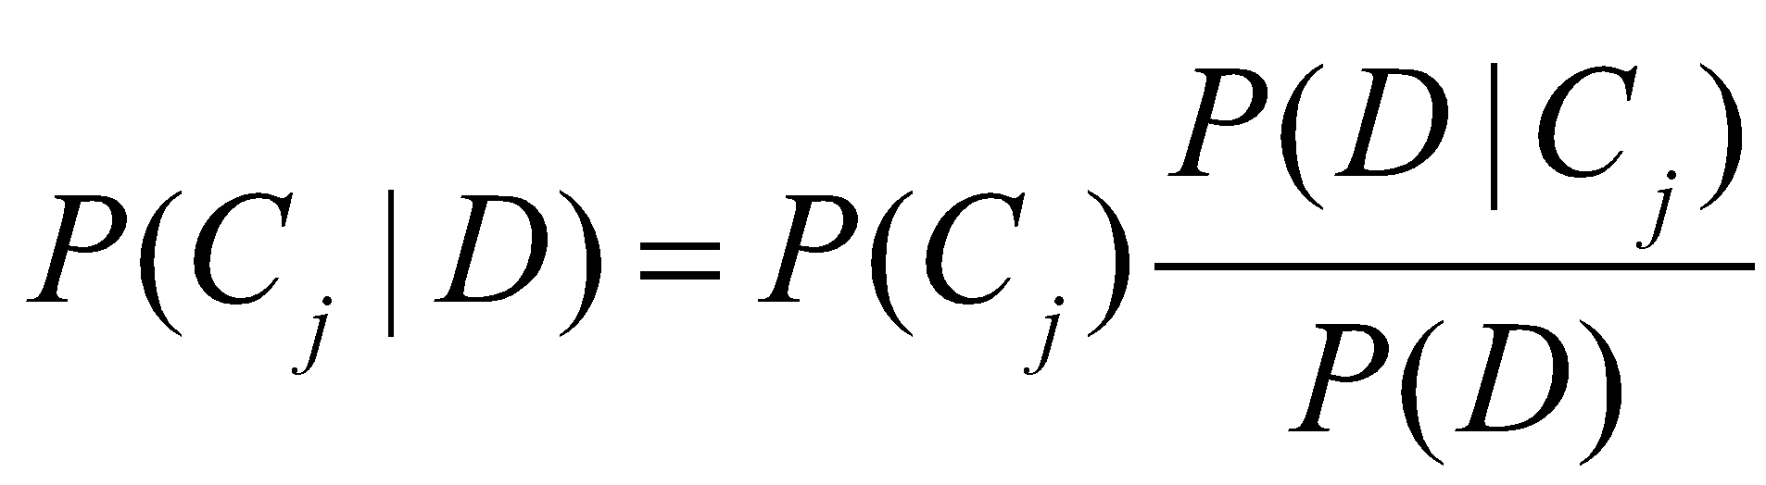
Bayesian Learning
// D_{t} is data at time t
// C_{j} is the concept j or theory j
// X_{t} is the background knowledge at time t
Objective
Given a set of new data D, and background knowledge X
Predict a concept C_{j} where P(C_{j}|DX) is the most probable
Incremental Learning (always learning)
When training data come one at a time, t = 0, 1, …, where X_{t+1} is the (background) knowledge learned at time t
Batch Learning (learn once for all)
When all the training example data D are known at the outset

Slide 7
Bayes Rule for Incremental Learning
// D_{t} is data
// C_{j} is the concept or theory
// X_{t} is the background
knowledge at time t
Bayesian is powerful for incremental learning
Let C be “your hypothesis theory”; D_{t} the “new data” at time t; and X_{t} the “background information” at time t
Your new theory “C”
after learning
from data “D_{t}”
Your previous theory “C”
before this learning step
How well is your previous theory “C” explaining the new data “D_{t}”
The result at time t becomes the prior backgound knowledge for time t+1
The likelihood of seeing the new data “D_{t}” regardless of your theory

Slide 8
An Example: Estimate a Coin Incrementally
Problem Statement
Randomly select X from two biased coins: {A(0.25), B(0.75)}
Repeat this step at time (t = 1, 2, 3, …)
Flip X, observe the result D_{t} = {H(ead), T(ail)}
Estimate which was the selected coin? That is: X=A? or X=B?
Assume the following
Your background knowledge C_{t=0} at time=0 is that you did not know which X is
Your experiment results are D = {T, T, H, …. }
// D_{t} is data at time t
// X_{j} is the concept or theory
// C_{t} is the background
knowledge at time t
Method: use the Bayesian Formula (see later slice)

Slide 9
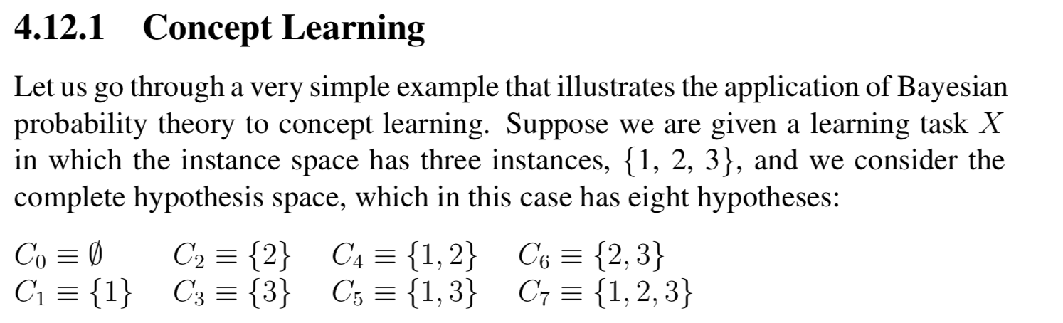
An Example: Concept Learning
Eight hypotheses
This is a very simple task: 3 instances and 2³=8 hypotheses
// D_{t} is data at time t
// C_{j} is the concept or theory
// X_{t} is the background
knowledge at time t
For details, please read section 4.12 in the ALFE book

Slide 10
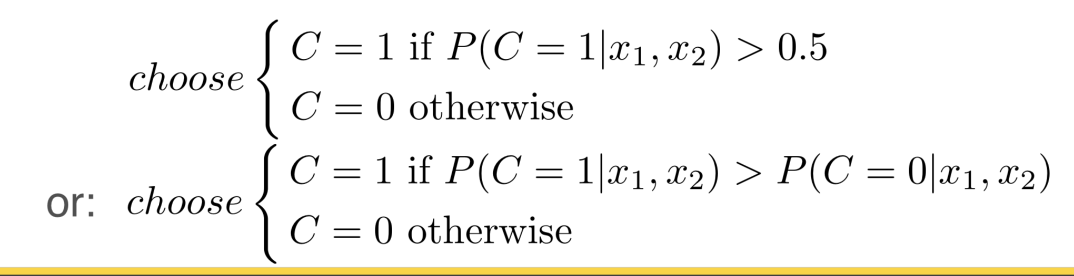
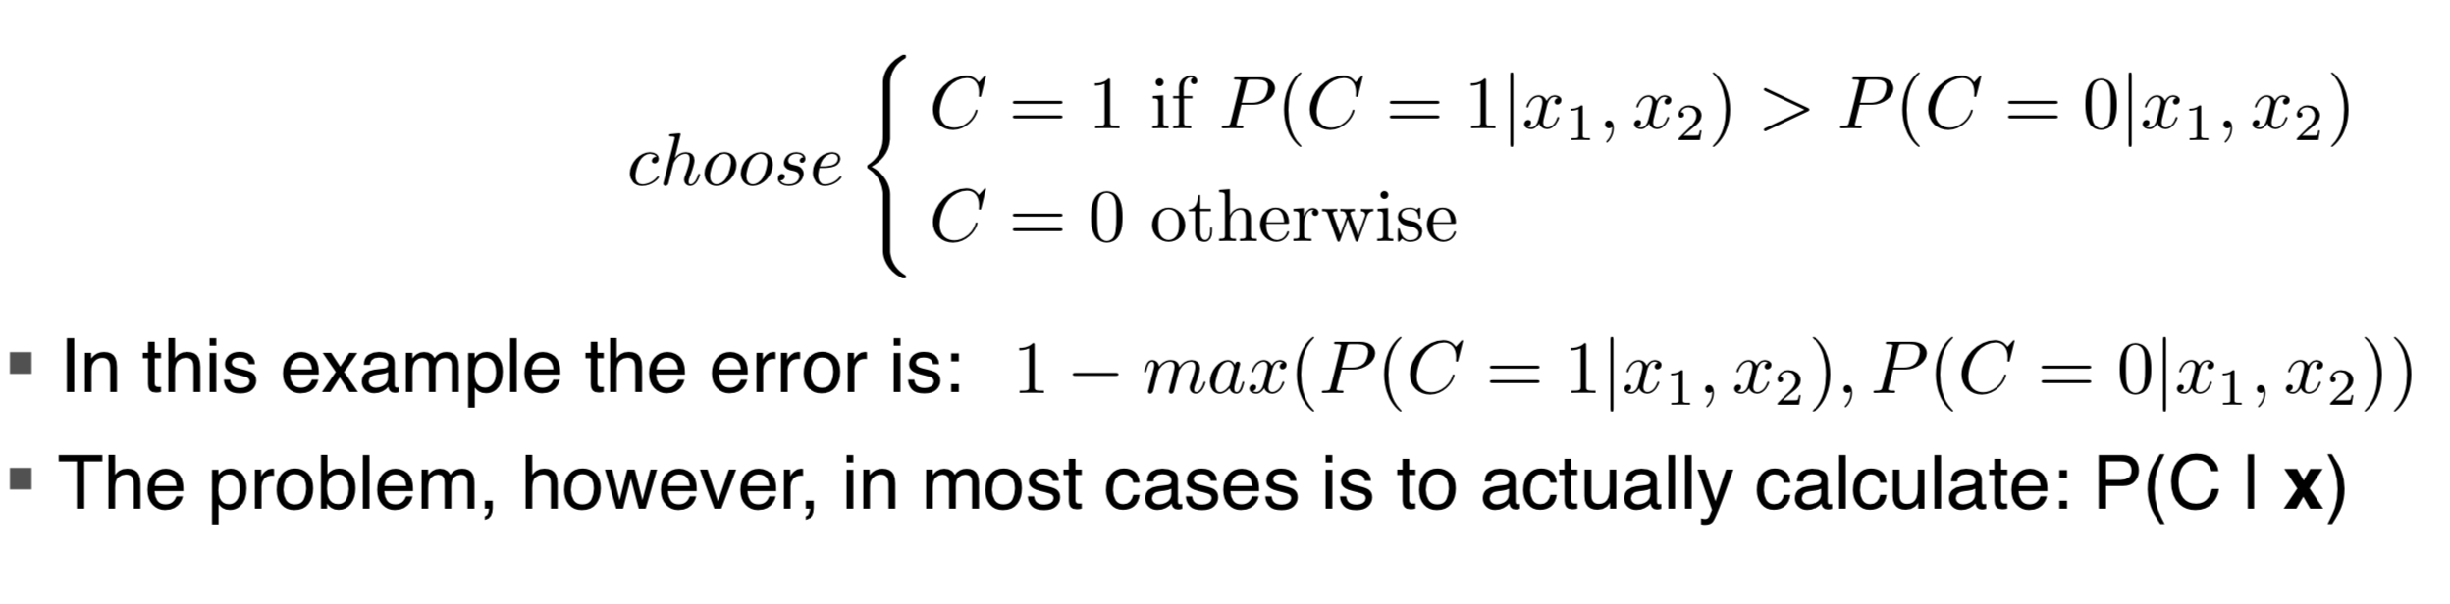
The Classification Problem
An example of Classification:
Given: price X₁ and power X₂
Learn: What is a “family car” C
Given Data X = [X₁, X₂, C] where C=1 if it is a family car, C=0 otherwise.
So if we do know P(C | X₁, X₂) when a new car arrives, then we can predict:
// X_{t} is data
// C_{j} is concept/hypothesis
or:

Slide 11
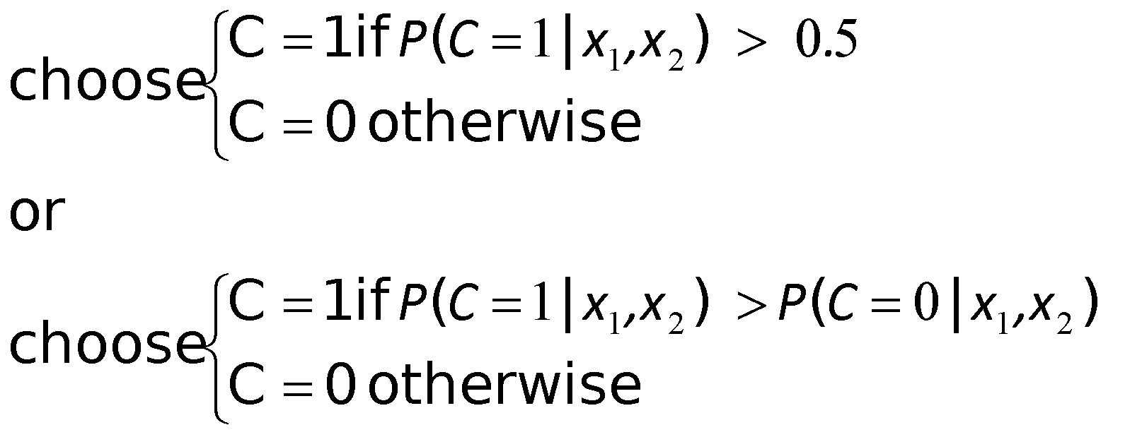
A Classification Example
Credit scoring: Inputs are income and savings.
Output is low-risk vs high-risk
Input: x = [x₁,x₂]^{T} ,Output: C = {0,1}
Prediction:
// X_{t} is data
// C_{j} is concept/hypothesis

Slide 12
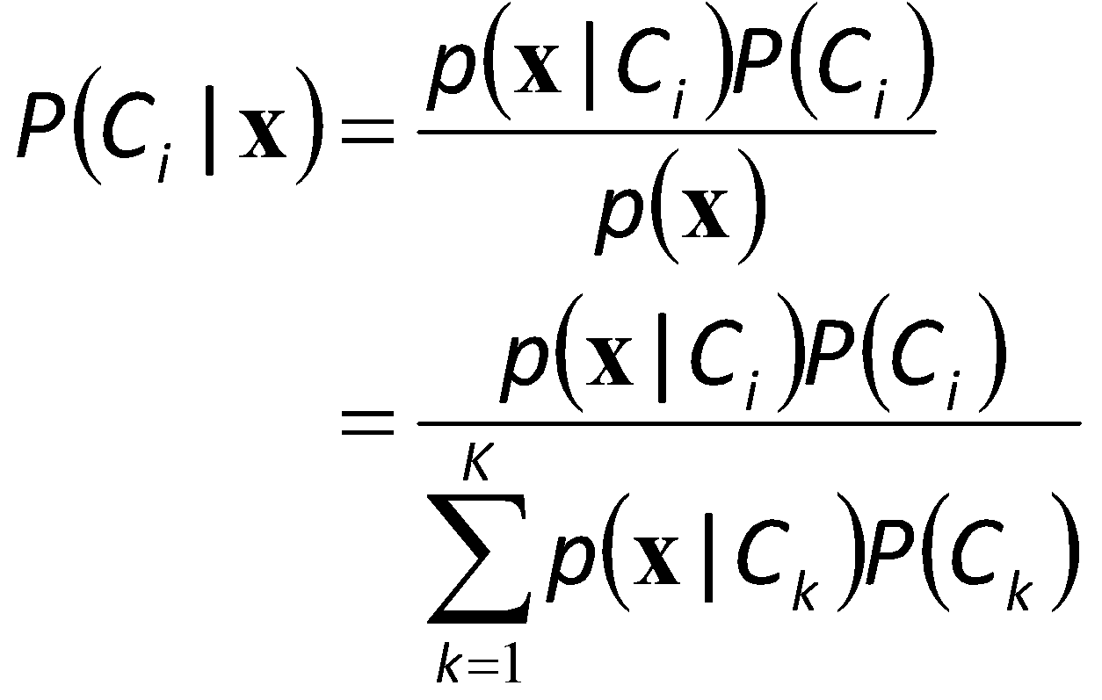
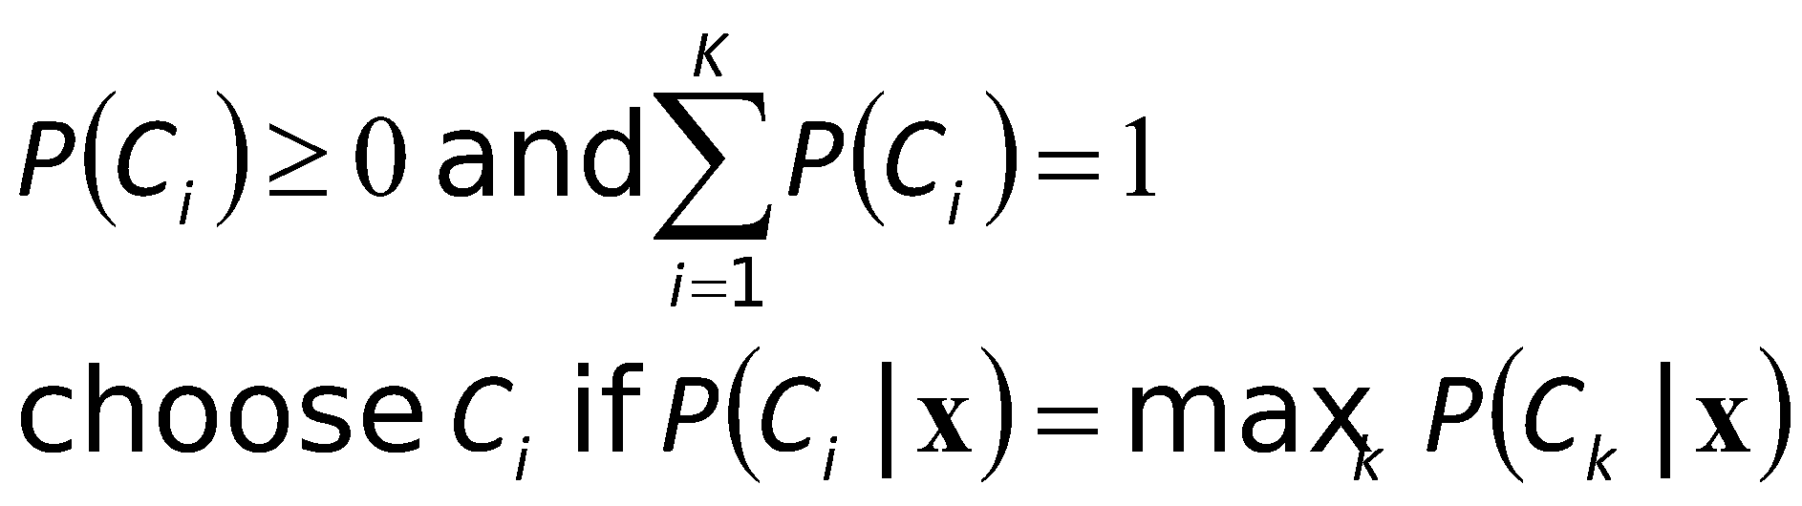
Bayesian Rule for Multiple Classes
// x_{t} is data
// C_{j} is concept/hypothesis

Slide 13
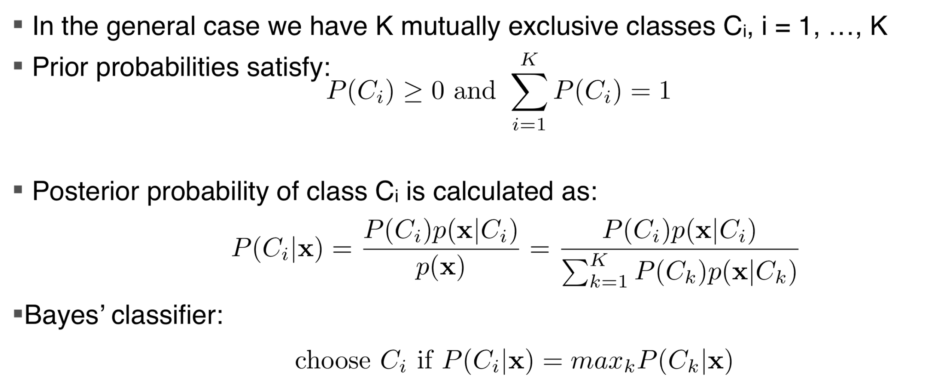
The Classification Definition
when data X is given
// x_{t} is data
// C_{j} is concept/hypothesis

Slide 14
INCREMENTAL LEARNING BATCH LEARNING

Slide 15
An Example: Estimate a Coin Incrementally
Problem Statement
Randomly select X from two biased coins: {A(0.25), B(0.75)}
Repeat this at each time step (t = 1, 2, 3, …)
Flip X and observe the result D_{t} = {H(ead), T(ail)}
Estimate X=A? or X=B?
Assume the results of your experiments are D = {H, H, T, H, …. }
i = 0:
P(A|C₀) = ½, P(B|C₀) = ½ // C₀ is “don’t know which coin was selected”
i = 1:
D₁ = H, P(A|C₀)=½, P(B|C₀)=½
P(A|D₁C₀) = P(A|C₀)P(D₁|AC₀)/P(D₁|C₀) = ½ ¼ / [(½ ¼)+(½ ¾)} = ¼
P(B|D₁C₀) = P(B|C₀)P(D₁|BC₀)/P(D₁|C₀) = ½ ¾ / [(½ ¼)+(½ ¾)} = ¾
i = 2:
D₂ = H, P(A|C₁)=¼ , P(B|C₁)=¾ // C₁ is “after learned from D₁”
P(A|D₂C₁) = P(A|C₁)P(D₂|AC₁)/P(D₂|C₁) = ¼¼ / [(¼¼)+(¾¾)} = 1/10
P(B|D₂C₁) = P(B|C₁)P(D₂|BC₁)/P(D₂|C₁) = ¾¾ / [(¼¼)+(¾¾)} = 9/10
i =3:
D₃ = T, P(A|C₂) = 1/10 , P(B|C₂) = 9/10 // C₂ is “after learned from D₂”
P(A|D₃C₂) = ?
P(A|D₃C₂) = ?
i =4:
D₄ = H, P(A|C₃) = ?, P(B|C₃) = ?
………………
………………
Two hypotheses: A, B;
Background Knowledge at time t: C_{t}
Incremental Bayesian Learning
P(A|D_{t+1}C_{t}) = P(A|C_{t})P(D_{t+1}|AC_{t})/P(D_{t+1}|C_{t})
P(B|D_{t+1}C_{t}) = P(B|C_{t})P(D_{t+1}|BC_{t})/P(D_{t+1}|C_{t})
What if there were 3 or n hypotheses?

Slide 16
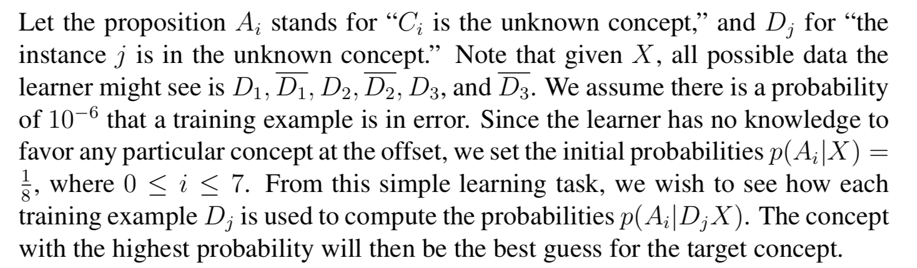
Incremental Bayesian Learning
When the new data D is given to us in a stream (one at a time):
Initially, t=0. and p(A_{i} | X_{t=0}) = 1/8, for all i
// D_{t} is data
// A_{i} or C_{j} is the concept or theory
// X_{t} is the background
knowledge at time t

Slide 17
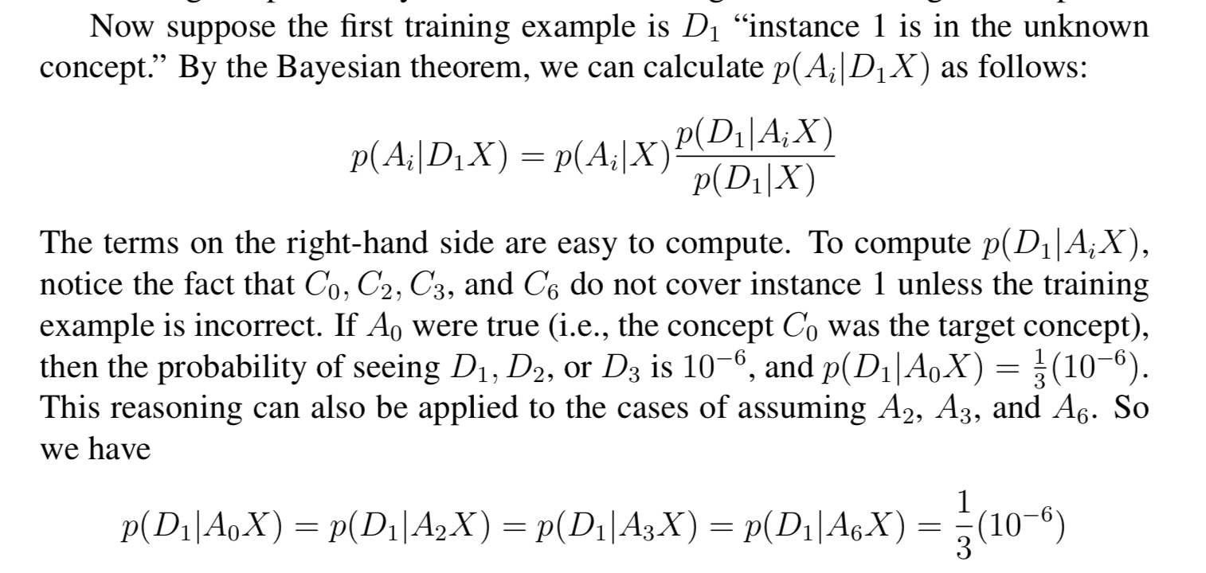
Incremental Learning from Example D₁

Slide 18
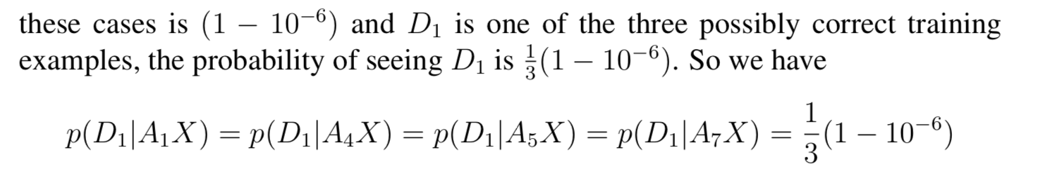
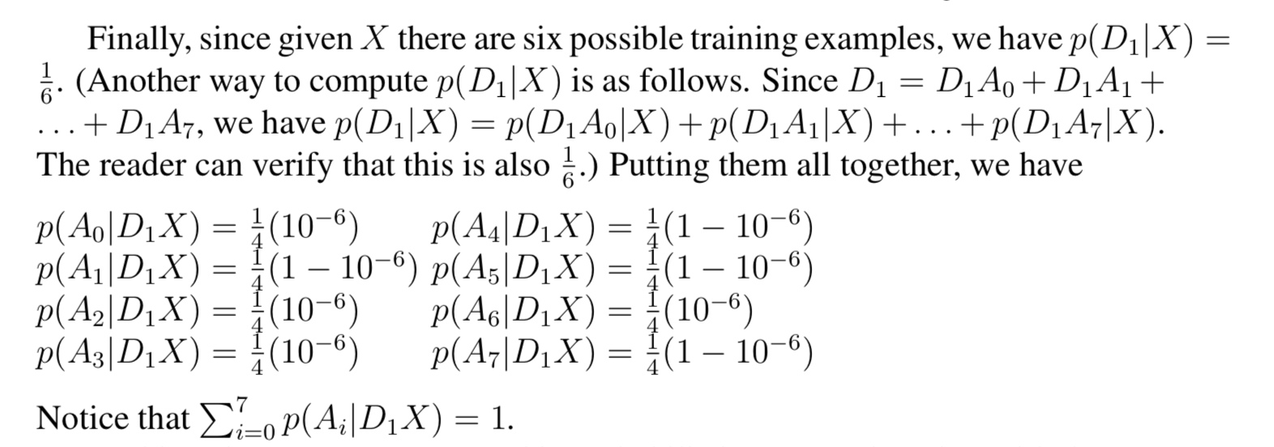
Incremental Learning from Example D₁
Now, which A_{i} is more likely?
Now t=1, and p(A_{i} | X_{t=1}) as shown

Slide 19
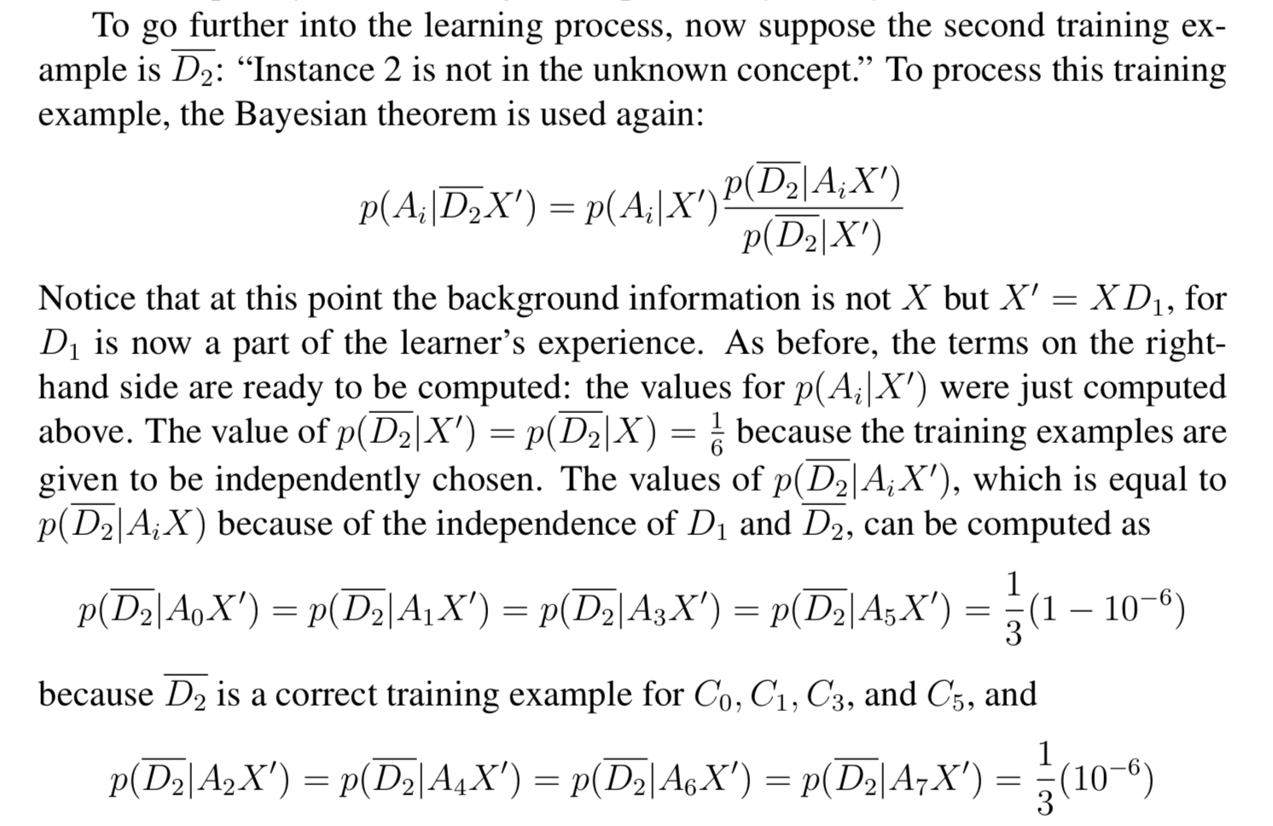
Incremental Learning from Example D₂

Slide 20
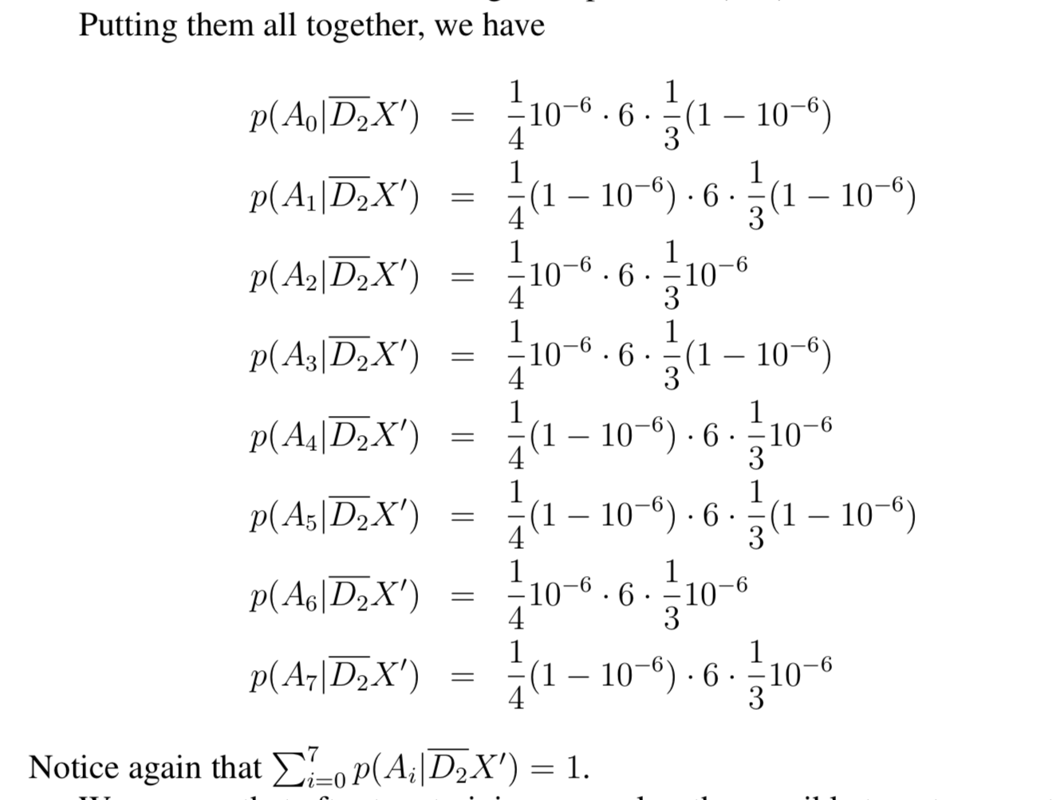
Incremental Learning from Example D₂
Now, which
Ai is more
likely?
Now t=2, and p(A_{i} | X _{t=2}) as shown

Slide 21
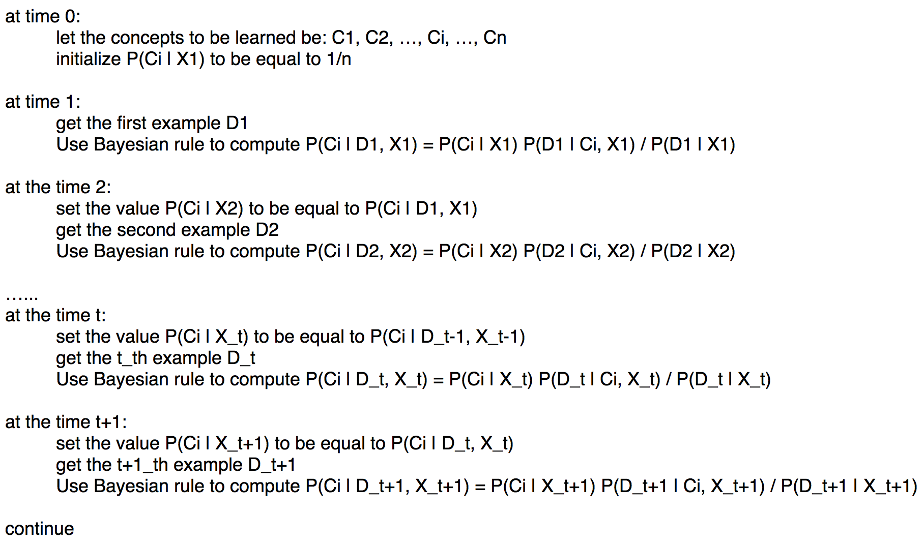
Incremental Bayesian Learning
// D_{t} is data
// C_{j} is the concept or theory
// X_{t} is the background
knowledge at time t

Slide 22
Batch Learning: When all data are given upfront
Let the hypotheses be C₁, C₂, …, C_{m}
To start, all C_{i} are equally likely, P(C_{i}) = 1/m
Given all training data D={D₁, D₂, …, D_{n}}
Where, each D_{i} is an example
Build a Bayesian classifier from D
P(C_{i}|D) = P(C_{i}) P(D|C_{i}) / P(D)
Use this Bayesian classifier to evaluate any new data in the future (no more learning)

Slide 23
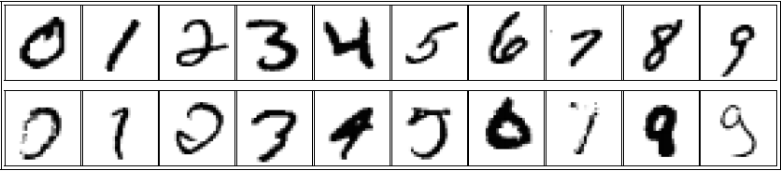
Example: Recognize Written Digits
Each instance Di above has k pixels, each pixel has value d={0,1}.
The class Cj is the “Digit j,” from “0” through “9”
We learn the terms on the right-hand-side of the Bayesian Rule, then
We predict C_{j} for any new image D_{x} where P(C_{j}|D_{x}) is the highest
// D_{t} is data
// C_{j} is the concept or hypothesis

Slide 24
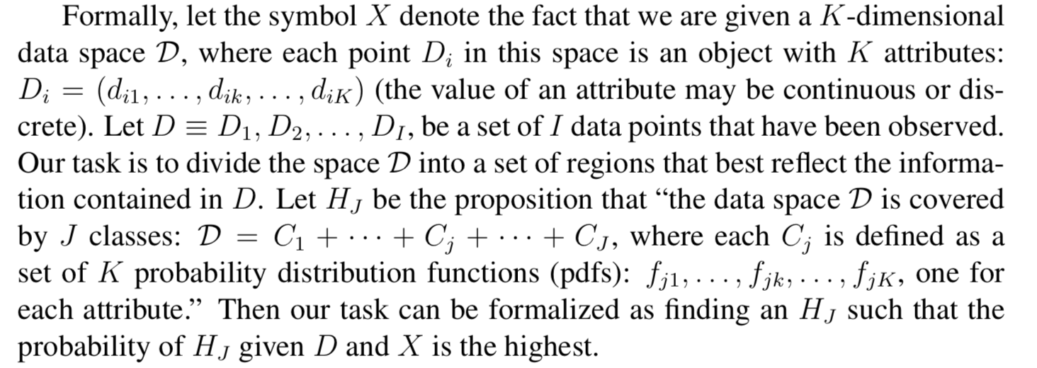
Bayesian Learning from a Batch
C_{j}
C_{j}
// D_{t} is data
// C_{j} is the concept or hypothesis
So our task is simply computing the terms on the right-hand
side of this equation for every C_{j} based on the given data D
P(C_{j}) = (# of C_{j} in D) / J // at time t=0
P(D|C_{j}) = Product of all P(d_{ik}| f_{ik}) for all i and k
P(D) = Sum of all P(DC_{j}) = Sum of all P(C_{j})P(D|C_{j}) for j

Slide 25
Example: Text Classification
Learn a function (from training data) that maps input into (discrete) classes
e.g.: Spam Detection
Classes: Spam vs. Not-Spam (binary classification)
Features: “Bag-of-words” represented as a vector (all the words in the email message, without accounting for oder)
Training Data: collection of email messages marked as Spam or not-Spam
Where does the training data come from?
Expert annotation, crowd-sourcing, found data, records from the past, user data, etc.

Slide 26
Naive Bayes for Text Classification
▪ Naive Bayes classification for text categorization
Very common baseline (can do surprisingly well)
Classify news stories, ..
Classify spam vs. not-spam
Bag-of-words features
P(Spam | words)
Spam
meeting
hello
bank
click

Slide 27
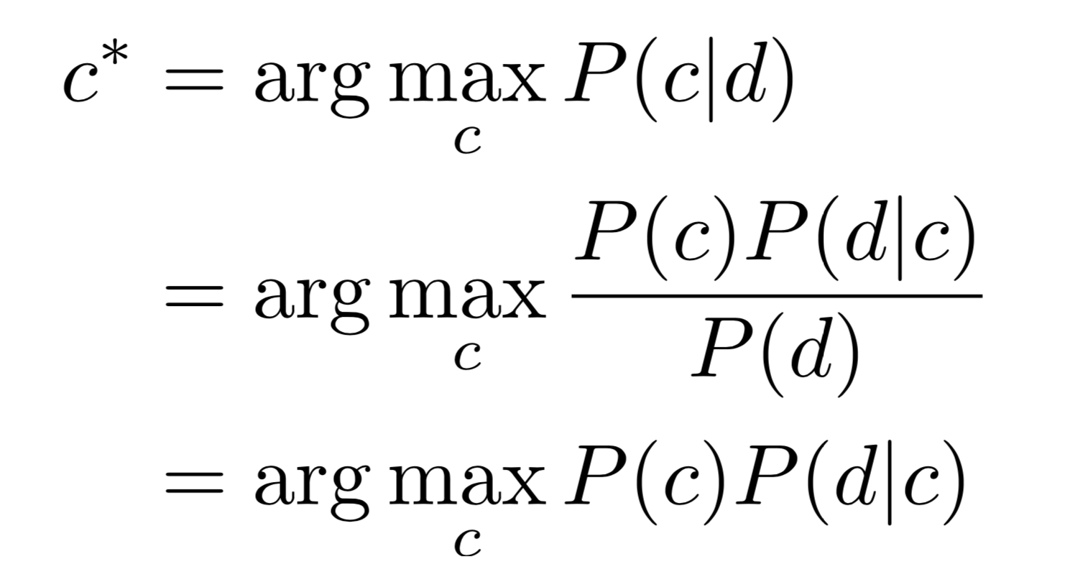
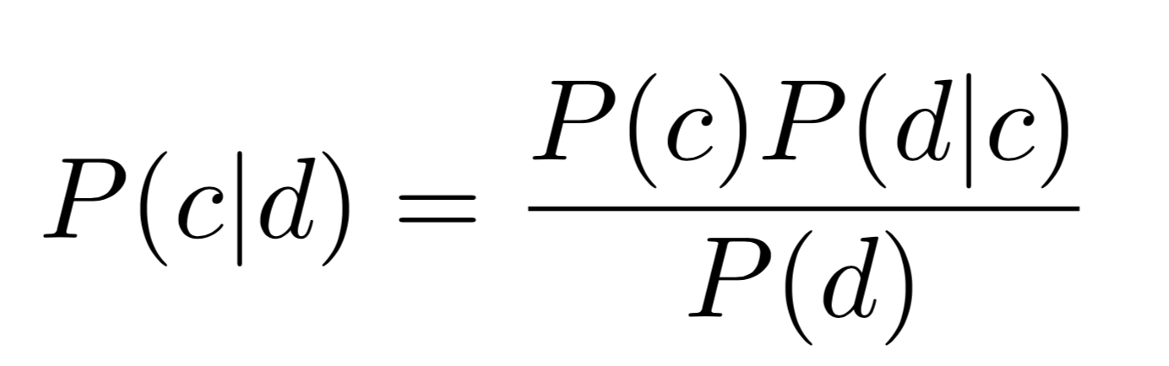
Naive Bayes for Text Classification
Suppose I want to know if a news article is about sports, politics, entertainment
Classes: sports, politics, entertainment
Probability that a document d belongs to class c: P(d |c)
Probability of class c given document d: P(c I d)
Compute for every class, and choose the max to predict which c*
// d_{t} is data
// c_{j} is the concept or hypothesis

Slide 28
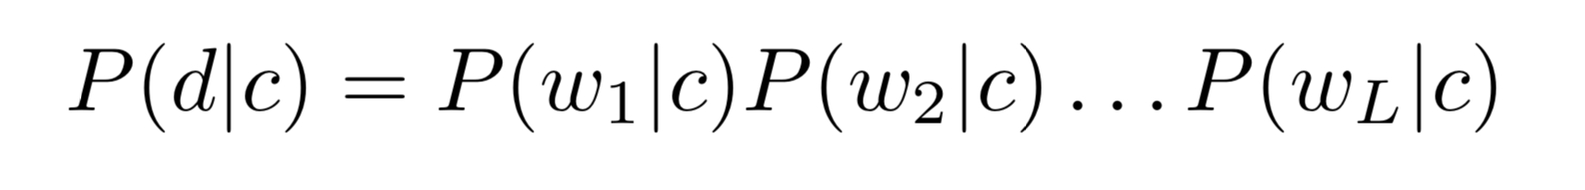
Naive Bayes for Text Classification
How do we estimate P(c)?
How do we estimate P(d | c)?
Naive Bayes assumption: words are independent
Please see the discussion slides for some detailed examples.

Slide 29
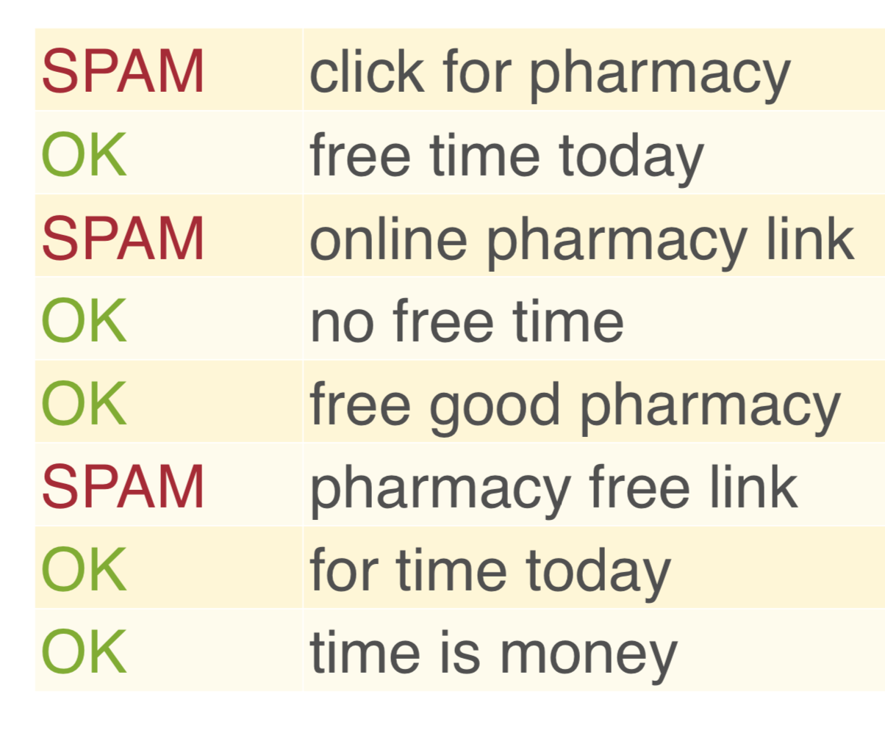
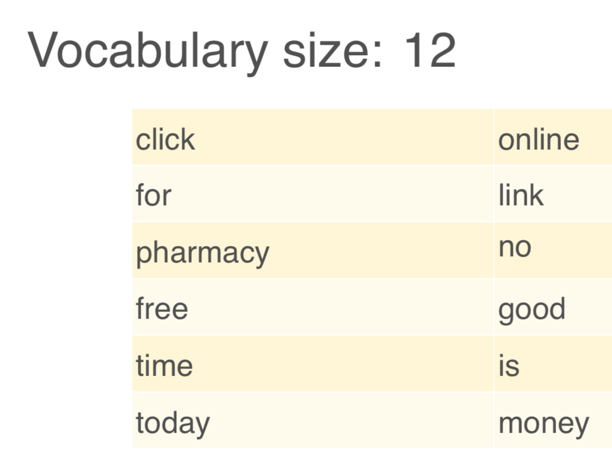
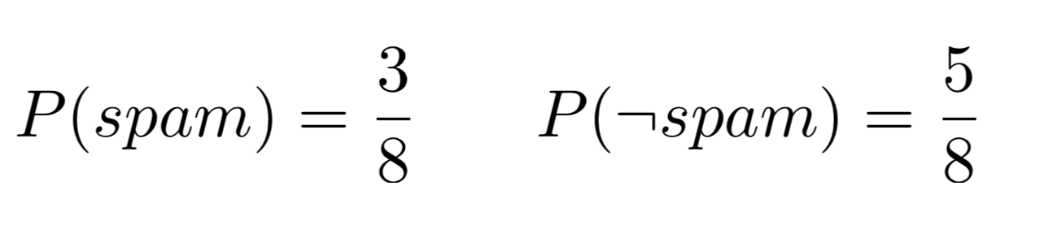
Spam Filtering
P (spam) =Maximum likelihood estimate
Given the data, we have

Slide 30
Spam Filtering with Naive Bayes
SPAM | click for pharmacy
OK | free time today
SPAM | online pharmacy link
OK | no free time
OK | free good pharmacy
SPAM | pharmacy free link
OK | for time today
OK | time is money
3
5
P (spam) =
P (¬spam) =
8
8
P (pharmacy|spam) = 3/9 = 1/3
P (pharmacy|¬spam) = 1/15
Msg = “Pharmacy for pharmacy”
P (spam|Msg) =?

Slide 31
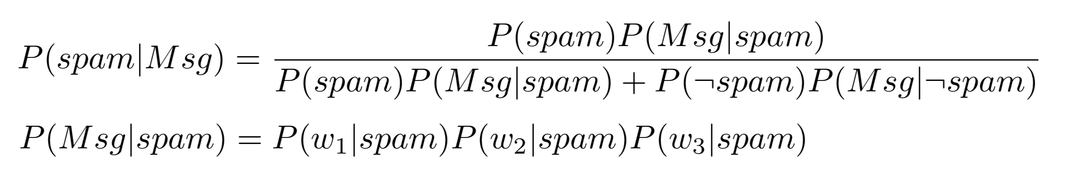
Spam Filtering with Naive Bayes
SPAM | click for pharmacy
OK | free time today
SPAM | online pharmacy link
OK | no free time
OK | free good pharmacy
SPAM | pharmacy free link
OK | for time today
OK | time is money
3
5
P (spam) =
P (¬spam) =
8
8
P ("pharmacy"|spam) = 1/3
P ("pharmacy"|¬spam) = 1/15
Msg = “Pharmacy for pharmacy” P (“for”| spam) = 1/9
P (”for"|¬spam) = 1/15

Slide 32
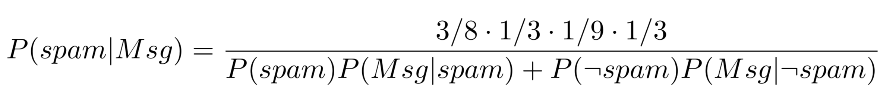
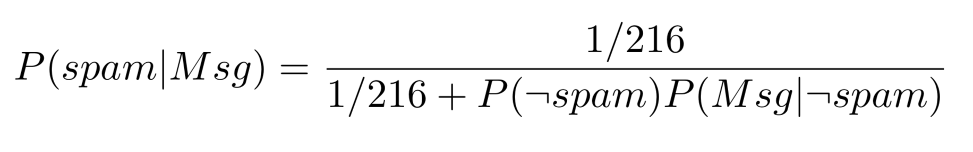
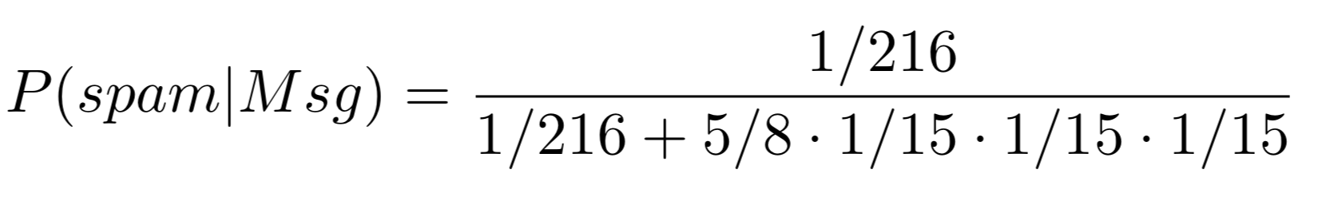
Spam Filtering with Naive Bayes
= 0.96

Slide 33
Spam Filtering with Naive Bayes
SPAM | click for pharmacy
OK | free time today
SPAM | online pharmacy link
OK | no free time
OK | free good pharmacy
SPAM | pharmacy free link
OK | for time today
OK | time is money
3
5
P (spam) =
P (¬spam) =
8
8
P (“time” | spam) = 0
P (“time”| ¬spam) = 4/15
Msg2 = “Time for pharmacy”
P (spam | Msg2) = 0.0 🡸 Is this classification good?
P (¬spam | Msg2) > 0.0

Slide 34
UNSUPERVISED LEARNING (CLUSTERING)

Slide 35
Unsupervised Learning (Clustering)
Type I: Clustering the data
Automatically group the data into clusters
Today’s lecture
Type II: Parameter Learning
States are known
Learn transitions, sensor models, & current state
Today’s lecture
Type III: Structural Learning (beyond the scope of CS561)
States are not known (only observations and actions are known)
Surprise-Based Learning (see www.isi.edu/robots for references)
POMDP where states are NOT known and must be learned from experiences
States are not just “symbols” but may have internal structures

Slide 36
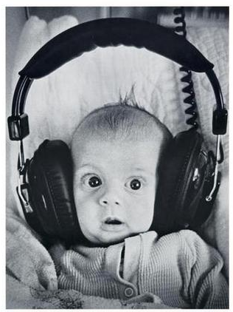
Clustering
Clustering systems:
Unsupervised learning
Detect patterns in unlabeled data
E.g. group emails or search results
E.g. find categories of customers
E.g. detect anomalous executions
Useful when don’t know what you’re looking for
Requires data, but no labels
Often get gibberish but may have surprisingly good results
Mom, dad, strangers?

Slide 37
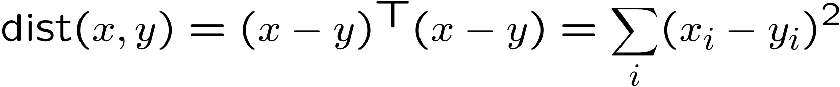
Clustering
Basic idea: group together similar instances
Example: 2D point patterns
What could “similar” mean?
One option: small (squared) Euclidean distance

Slide 38
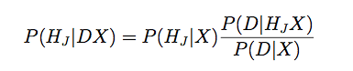
An Example of “Clustering”
1.0, 3.0
101.0, 103.0
Given the four data points D above
Cluster them in one, two, three, or four clusters?
Let the hypothesis be H₁, H₂, H₃, H₄
Choose the H_{J} such that P(H_{J}|DX) is the highest
Where X is the background knowledge
Bayes Model
How well hypothesis explain data?
How likely is the data?
How likely is the hypothesis?

Slide 39
Different Hypotheses for Clustering (Assume Gaussian Distributions)
1 cluster
H₁
1.0, 3.0
101.0, 103.0
H₂
2 clusters
1.0, 3.0
101.0, 103.0
H₄
4 clusters
1.0, 3.0
101.0, 103.0

Slide 40
Clustering Algorithms
Naïve Bayes Model (AUTOCLASS)
K-Means
Agglomerative

Slide 41
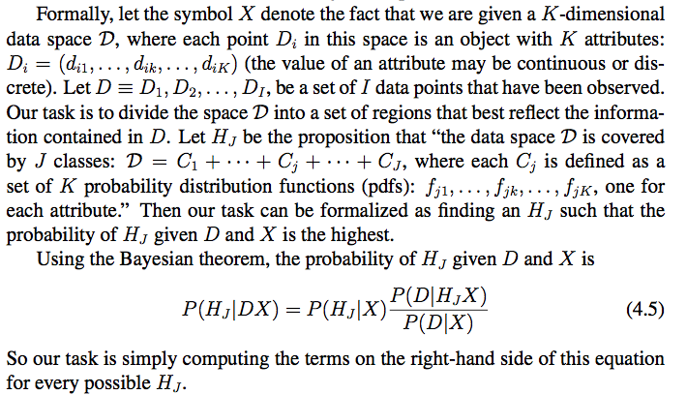
A Naïve Bayes Model
// D_{t} is data
// H_{j} is the concept or theory
// X_{t} is the background
knowledge at time t
Example 1: data D = freshly caught fishes, cluster J = types of fishes
Example 2: data D = star observations, cluster J = type of stars

Slide 42
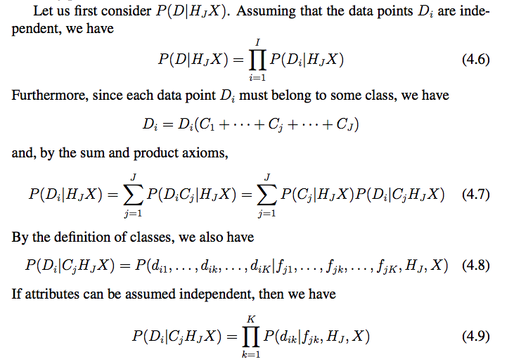
A Naïve Bayes Model
Naïve
Background knowledge
Naïve
The Autoclass Clustering Algorithm

Slide 43
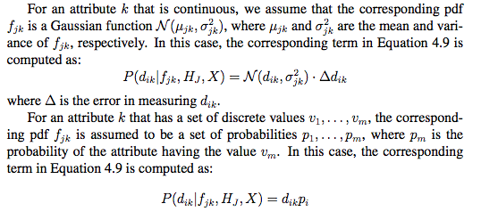
AUTOCLASS Algorithm

Slide 44
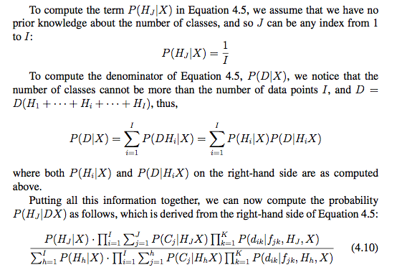
AUTOCLASS Algorithm

Slide 45
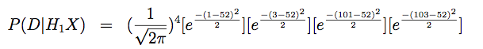
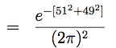
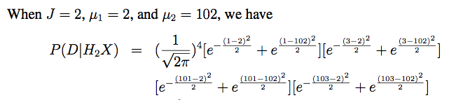
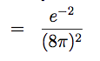
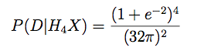
Back to the example
1 cluster
2 clusters
P(D|H₃X) = ……
4 clusters
Since P(X|H₂X) > P(X|H₃X) > P(X|H₄X) > P(X|H₁X), the Bayesian theorem tells that H₂ is the best hypothesis, which matches to our intuition!

Slide 46
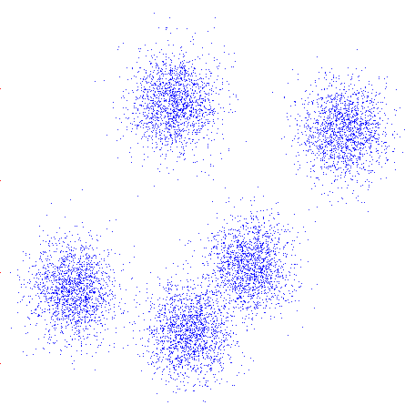
K-Means Clustering
An iterative clustering algorithm
Pick K random points as cluster centers (means)
Alternate:
Assign data instances to closest mean
Assign each mean to the average of its assigned points
Stop when no points’ assignments change

Slide 47
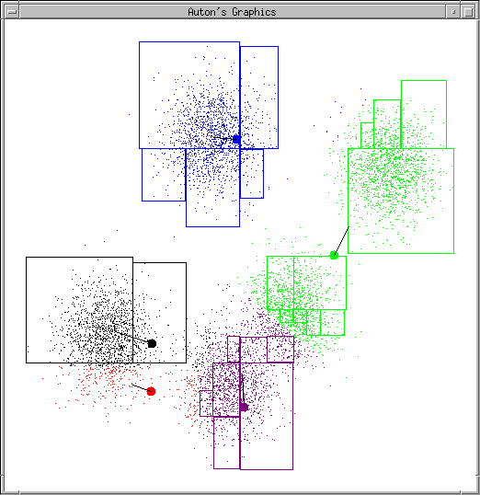
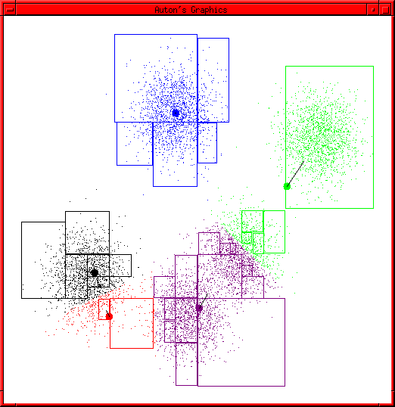
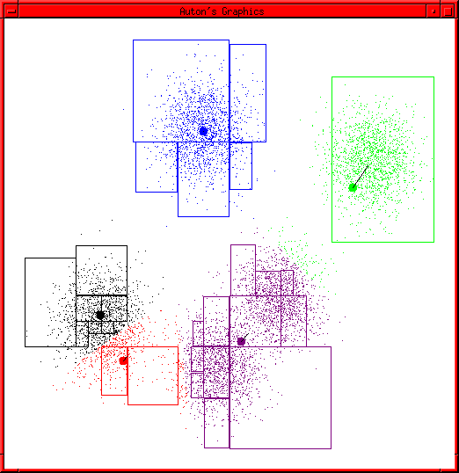
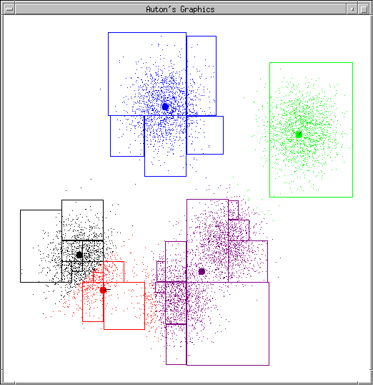
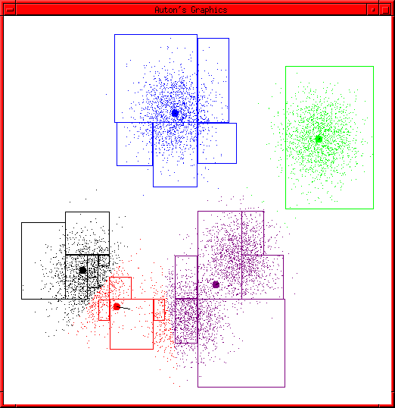
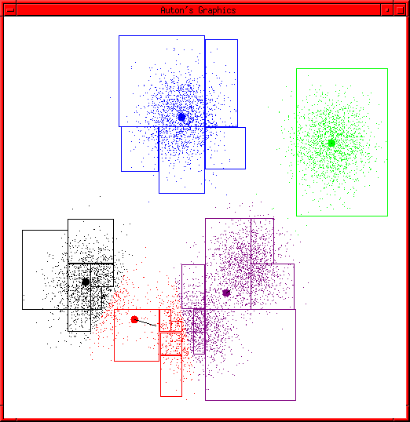
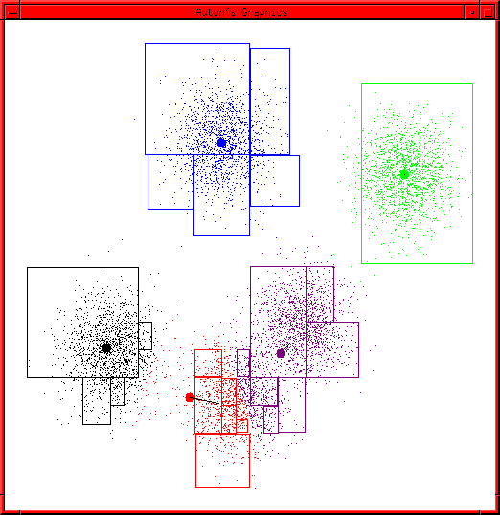



K-Means Example

Slide 48

K-Means as Optimization
Consider the total distance to the means:
Each iteration reduces φ
Two stages each iteration:
Update assignments: fix means c,
change assignments a
Update means: fix assignments a,
change means c
points
means
assignments

Slide 49



Phase I: Update Assignments
For each point, reassign to the closest mean:
Can only decrease total distance φ !

Slide 50

Phase II: Update Means
Move each mean to the average of its assigned points:
Also can only decrease total distance…

Slide 51
Initialization
K-means is non-deterministic
Requires initial means
It does matter what you pick!
What can go wrong?
Various schemes for preventing this kind of thing: variance-based split / merge, initialization heuristics

Slide 52
K-Means Getting Stuck
A local optimum:
Why doesn’t this work out like the earlier example, with the purple taking over half the blue?

Slide 53
K-Means Questions
Will K-means converge?
To a global optimum?
Will it always find the true patterns in the data?
If the patterns are very very clear?
Will it find something interesting?
Do people ever use it?
How many clusters to pick?

Slide 54
Agglomerative Clustering
Agglomerative clustering:
First merge very similar instances
Incrementally build larger clusters out of smaller clusters
Algorithm:
Maintain a set of clusters
Initially, each instance in its own cluster
Repeat:
Pick the two closest clusters
Merge them into a new cluster
Stop when there’s only one cluster left
Produces not one clustering, but a family of clusters represented by a dendrogram

Slide 55
Agglomerative Clustering
How should we define “closest” for clusters with multiple elements?
Many options
Closest pair (single-link clustering)
Farthest pair (complete-link clustering)
Average of all pairs
Ward’s method (min variance, like k-means)
Different choices create different clustering behaviors

Slide 56

Clustering Application
Top-level categories: supervised classification
Story groupings:
unsupervised clustering

Slide 57
Clustering Algorithms (Review)
Naïve Bayes Model (AUTOCLASS)
Select M_{i} that has the best P(D|M_{i}),
K-Means
Loop until no improvement
Assign data to the nearest cluster
Adjust clusters to fit the assignments
Agglomerative
Always merge the pair of “closest” clusters

Slide 58
THE EM ALGORITHM

Slide 59
The EM Algorithm
It is not an “algorithm”, it is a Framework!
A loop of two phases
Estimation (using Maximum likelihood)
Modification (using Expectation maximization)
For example, when we do clustering
Phase 1: update assignment (data to cluster)
Phase 2: update means (adjust clusters)

Slide 60



The EM Algorithm
A very general framework
Many forms & applications
Clustering with Gaussians
Bayesian net with hidden variables
Hidden Markov models (HMM)
Partially Observable Markov Decision Process (POMDP)
See e.g., ALFE 5.10
Others
We describe it by form/applications
Clustering
Learning POMDP 🡸 when states are known

Slide 61

The Big Ideas
Training (aka, “parameter estimation” or “maximum likelihood estimation”)
Given data X={x₁, x₂, …, x_{N}},
Find a model with parameters θ that p(X|θ ) is maximum
Define p(X|θ ), and then solve to obtain θ
Testing (aka, “classification”, “prediction”, “expectation maximization”)
Given a test data x,
Predict a class C_{i} where P(x|C_{i}) = P(x|θ_{i}) is maximum
Note
A data point x can have a single feature or multivariate

Slide 62

Maximum Likelihood Estimation
Notes:
the arguments of the maxima

Slide 63





Example: MLE (1 coin)
Notes:
G(p³(1-p)⁵)/G(p) = 3p²(1-p)⁵ - p³5(1p)⁴ = 0
3p²(1-p)⁵ = p³5(1-p)⁴
3(1-p) = 5p
3 – 3p = 5p
P = 3/8

Slide 64
Example: MLE
Find the best θ for P(X |θ ) = θ ³ (1-θ ) ⁵
Set its partial derivative to 0:
3θ ²(1-θ )⁵ – 5θ ³(1-θ )⁴ = 0
Solve this equation
3θ ²(1-θ )⁵ = 5θ ³(1-θ )⁴
3(1-θ ) = 5θ
3 – 3θ = 5θ
θ = 3/8

Slide 65

MLE Example (2 coins)

Slide 66


Maximum Likelihood Estimation
Given X = {x^{t}}, a sample of data
X is independent and identically distributed
X is drawn from a known density P(x|θ)
Compute P(θ | X)
Using Bayesian Rule P(θ|X)=P(θ)P(X|θ)/P(X) ~ P(X|θ)
Using the independence of X
Choose a model θ that makes X most likely

Slide 67

Expectation Maximization
P(CoinA | Row1) = P(CoinA, Row1) / P(Row1)
(0.6)⁵(0.4)⁵/ [(0.6)⁵(0.4)⁵ + (0.5)⁵(0.5)⁵] = 0.45

Slide 68
EM Example (complete)

Slide 69
Another EM Example
Given an experience to an agent in an environment
E.g., the little prince’s experience on his planet
How does the agent build a better model for its environment?
P(M_{t=T}|E_{1:T})
Baum-Welch Learning Procedure
For learning HMM or POMDP when the states are known

Slide 70




HMM/POMDP (A Review)
1. Actions
2. Percepts (observations)
3. States
4. Appearance: states 🡪 observations
5. Transitions: (states, actions) 🡪 states
6. Current State
Three key components:
- Sensor model θ=p(z|s)
- Action model P(s|s,a)
- Current state π_{t}(s) (localization)

Slide 71


Little Prince Example
{P(s3|s0,f)=.51, P(s2|s1,b)=.32, P(s4|s3,t)=.89, …}
{P(rose|s0)=.76, P(volcano|s1)=.83, P(nothing|s3)=.42, …}

Slide 72

Learning HMM/POMDP
M = (B, Z, S, P, θ, π)
Task:
Given B, Z, S, and an experience
Improve P, θ, π.
“Improve” means better match the experience
How do we do that?
EM: Bayesian Again!
P(E|M): Use M to explain E
Use the explanation to improve P(M|E)
C is the background knowledge

Slide 73

Equations for “Improving based on explanation”
Assume A and M
are independent: P(A|MC)=P(A|C)
improving
explanation

Slide 74
The EM Algorithm
E-Step: Estimate P(E|M) the likelihood of the experience E given the model M
Using the model M to explain the experience E
M-Step: Maximizing the parameters of the model M using the knowledge learned from the experience
Using the explanation to improve the model
E.g., Baum-Welch Learning Procedure

Slide 75

Baum-Welch Learning Procedure
Using the explanation of the experience to change the model:

Slide 76


Update P, θ, π using α, β, γ, ξ
(Smooth) Use the whole experience to determine the beginning
From all states s_{i}, how many transit to s_{j}
From all s_{i}, how many look like z_{k}
(Smooth) Use the whole model
to determine the next state

Slide 77

Little Prince Example
Computing α, β, γ, ξ using the experience
E = {rose}, forward, {nothing}, forward, {volcano}
States: s₀, s₁, s₂, s₃
Init state distribution: 0.25, 0.25, 0.25, 0.25
Transitions: P( S_{j} | S_{i}, forward):
Observations Z=<rose, volcano, nothing>
Sensor model:
S₀ S₁ S₂ S₃
S₀ S₁ S₂ S₃
S₀ S₁ S₂ S₃

Slide 78


Forward Procedure
Compute step by step:
α_{t}(i): the probability at the state s_{i} at time t given E

Slide 79


Compute α values
α₁(s₃)=0.25*0.8=0.2
α₁(s₂)=0.25*0.5=0.125
α₁(s₁)=0.25*0.2=0.05
α₁(s₀)=0.25*0.4=0.1
α₂(s₃)=(.2*.1+.125*.1+.05*.1+.1*.4)*0.1
α₂(s₂)=(.2*.5+.125*.1+.05*.3+.1*.2)*0.2
α₂(s₁)=(.2*.3+.125*.3+.05*.3+.1*.1)*0.2
α₂(s₀)=(.2*.1+.125*.5+.05*.3+.1*.3)*0.1
S₀ S₁ S₂ S₃

Slide 80
Compute α values
α₁(s₃)=0.2
α₁(s₃)=0.125
α₁(s₁)=0.05
α₁(s₀)=0.1
α₂(s₃)=0.00775
α₂(s₂)=0.0295
α₂(s₁)=0.0245
α₂(s₀)=0.0125
α₃(s₃)=(.00775*.1+.0295*.1+.092*.1+.0125*.4)*0.1
α₃(s₂)=(.00775*.5+.0295*.1+.092*.3+.0125*.2)*0.3
α₃(s₁)=(.00775*.3+.0295*.3+.092*.3+.0125*.1)*0.6
α₃(s₀)=(.00775*.1+.0295*.5+. .092*.3+.0125*.3)*0.5

Slide 81



Compute β_{t}(i) by Backward Procedure
β_{t}(i): given E, the probability of being at the state s_{i} at time t

Slide 82

Compute β values
β₂(s₃)=(.1*.1+.5*.3+.3*.6+.1*.5)*1.0
β₂(s₂)=(.1*.1+.1*.3+.3*.6+.5*.5)*1.0
β₂(s₁)=(.1*.1+.3*.3+.3*.6+.3*.5)*1.0
β₂(s₀)=(.4*.1+.2*.3+.1*.6+.3*.5)*1.0
β₃(s₃)=1.0
β₃(s₂)=1.0
β₃(s₁)=1.0
β₃(s₀)=1.0
S₀ S₁ S₂ S₃

Slide 83
Compute β values
β₁(s₃) = fill in here in the class
β₁(s₂)=
β₁(s₁)=
β₁(s₀)=
β₂(s₃)=0.39
β₂(s₂)=0.47
β₂(s₁)=0.43
β₂(s₀)=0.31
β₃(s₃)=1.0
β₃(s₂)=1.0
β₃(s₁)=1.0
β₃(s₀)=1.0

Slide 84

ϒ_{t}(i) Value: Putting α and β together
ϒ_{t}(i) is the probability of being at state s_{i} at time t given the entire experience E_{1:T}
S1 S2 S3 S4
S1 S2 S3 S4
s_{i}
S1 S2 S3 S4
S1 S2 S3 S4
t

Slide 85
Compute γ = α*β
γ₁(s₃)
γ₁(s₂)
γ₁(s₁)
γ₁(s₀)
γ₂(s₃)
γ₂(s₂)
γ₂(s₁)
γ₂(s₀)
γ₃(s₃)
γ₃(s₂)
γ₃(s₁)
γ₃(s₀)

Slide 86
Putting α and β together
α₁(s₃)=0.2
α₁(s₃)=0.125
α₁(s₁)=0.05
α₁(s₀)=0.1
β₁(s₃)
β₁(s₂)
β₁(s₁)
β₁(s₀)
α₂(s₃)=0.00775
α₂(s₂)=0.0295
α₂(s₁)=0.092
α₂(s₀)=0.0125
β₂(s₃)=0.39
β₂(s₂)=0.47
β₂(s₁)=0.43
β₂(s₀)=0.31
α₃(s₃)=.0017925
α₃(s₂)=.0110775
α₃(s₁)=.024015
α₃(s₀)=.0234375
β₃(s₃)=1.0
β₃(s₂)=1.0
β₃(s₁)=1.0
β₃(s₀)=1.0

Slide 87

ξ_{t}(i,j) Value
ξ_{t}(i,j) is the probability of making transition from s_{i} to s_{i} at time t in the experience E_{1:T}
S1 S2 S3 S4
S1 S2 S3 S4
s_{i}
b_{t}
s_{j}
S1 S2 S3 S4
S1 S2 S3 S4
t t+1

Slide 88
Improve the model by explanation Update P, θ, π using α, β, γ, ξ
Use the whole experience to determine the beginning
From all s_{i} in E, how many go to s_{j}
From all s_{i} in E, how many appear as z_{k}
Use the whole experience to determine
the distribution for the next state

Slide 89
The General EM Algorithm
E-Step: Estimate P(E|M) the likelihood of the experience E given the model M
E.g., computing α, β, γ, ξ using the experience
K-means: assigning data to the (closest) clusters
M-Step: Maximize the parameters of the model M using the knowledge (e.g., explanations) learned from the experience
E.g., update P, θ, π using α, β, γ, ξ
K-means: move the clusters based on the assignments

Slide 90
Comments on EM
The most general and powerful learning method
Many existing algorithms are special cases of EM
Tremendous application potentials
Robot navigation, localization, mapping, SLAM, manipulation, planning, etc.
Natural language processes (IBM’s Watson)
Data Mining
Gaming that can improve themselves
Discovering patterns from genetic and health data

